Slide 1
WALMART SALES DATA ANALYSIS
By Amol Shirsat

Slide 2

INTRODUCTION
This report analyzes a Walmart sales dataset containing transaction-level data from three fictional branches located in Yangon, Mandalay, and Naypyitaw (Myanmar). The dataset includes details such as invoice ID, branch, city, customer type, product line, unit price, quantity, tax, total sales, date, time, payment method, gross income, and customer ratings. From this data we will identify sales performance & trends, customer satisfaction etc.

Slide 3
DATASET OVERVIEW
CONSIST OF FOLLOWING KEY COLUMNS:
INVOICE ID : UNIQUE IDENTIFICTION NUMBER
BRANCH :STORE BRANCH WHERE THE SALES OCCURRED( EX.A,B,C)
CITY :BRANCH LOCATION
CUSTOMER TYPE : WHETHER THE CUSTOMER IS A MEMBER OR NORMAL.
GENDER : GENDER OF THE CUSTOMER
PRODUCT LINE :THE CATEGORY OF THE PRODUCT SOLD (E.G., HEALTH AND BEAUTY)
UNIT PRICE : PRICE OF ONE UNIT OF THE PRODUCT
QUANTITY :NUMBER OF UNITS PURCHASED
TOTAL :TOTAL BILL AMOUNT INCLUDING TAX
DATE & TIME :DATE & TIME OF PURCHASE
PAYMENT : PAYMENT METHOD USED (E.G., CASH, CREDIT CARD, EWALLET).
GROSS_INCOME : GROSS PROFIT FROM THE SALE.
RATING : CUSTOMER SATISFACTION RATING (SCALE OF 1 TO 10).

Slide 4

OBJECTIVE
The Objective based on SQL Analysis:
To Calculate Key Performance Indices(KPI) in Walmart Sales also Identifying top Performing Branches and Cities.
To analyze Product line performance and customer purchasing patterns.
To determine Popular Payment methods.
To evaluate Sales Trends over time.
To measure Customer Satisfaction through Ratings.
To provide Data driven recommendation for improving revenue and Profitability.

Slide 5
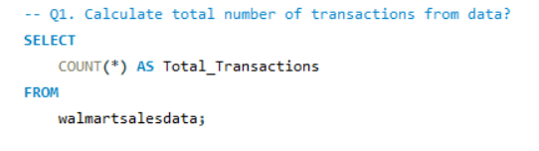
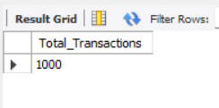
ANALYSIS:
Q1. Calculate total number of transactions from data?
Answer:

Slide 6
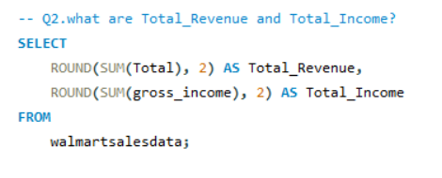
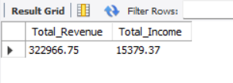
ANALYSIS:
Q2. What are Total Revenue and Total Income?
Answer:

Slide 7
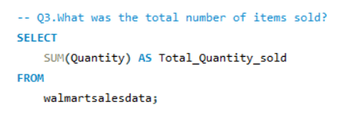
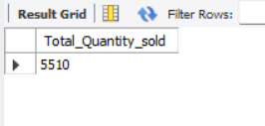
ANALYSIS:
Q3. What was the total number of items sold?
Answer:

Slide 8
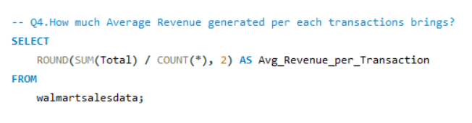
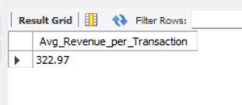
ANALYSIS:
Q4. How much Average Revenue generated per each transactions brings?
Answer:

Slide 9
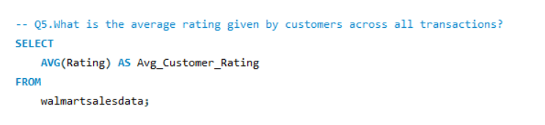
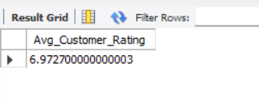
ANALYSIS:
Q5. What is the average rating given by customers across all transactions?
Answer:

Slide 10
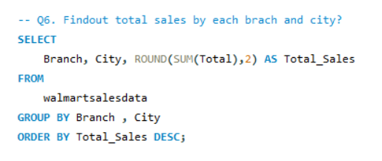
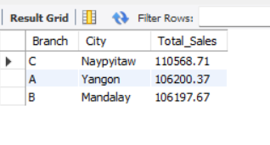
ANALYSIS:
Q6. Find out total sales by each branch and city?
Answer:

Slide 11
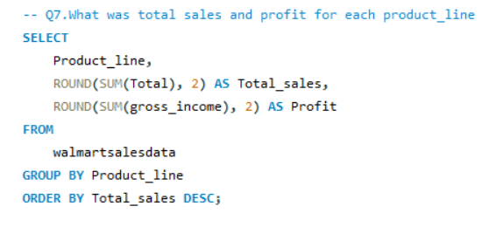
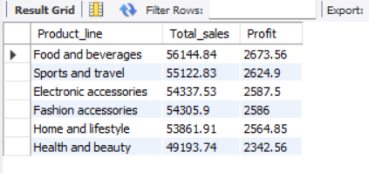
ANALYSIS:
Q7. What was total sales and profit for each product line
Answer:

Slide 12
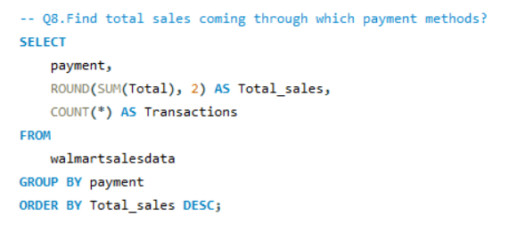
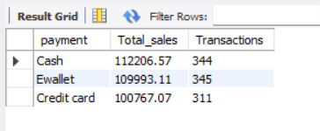
ANALYSIS:
Q8. Find total sales coming through which payment methods?
Answer:

Slide 13
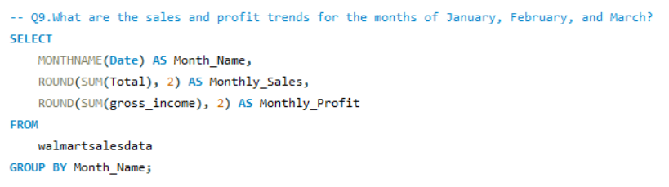
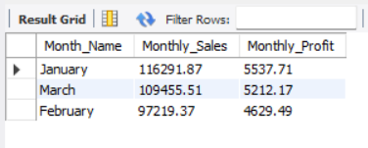
ANALYSIS:
Q9.What are the sales and profit
trends for the months of January, February, and March?
Answer:

Slide 14
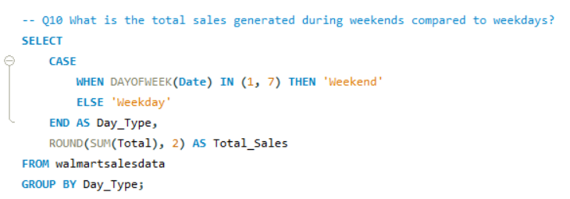
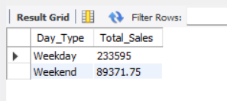
ANALYSIS:
Q10. What is the total sales generated during weekends compared to weekdays?
Answer:

Slide 15
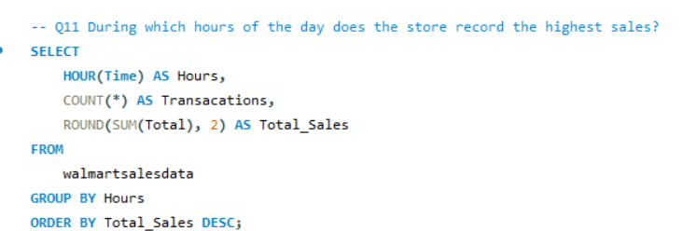
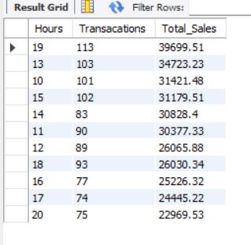
ANALYSIS:
Q11. During which hours of the day does the store record the highest sales?
Answer:

Slide 16
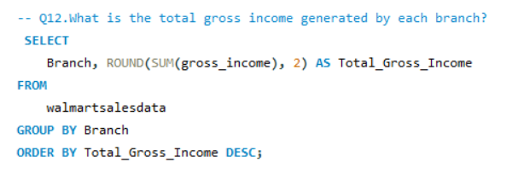
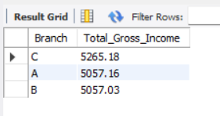
ANALYSIS:
Q12. What is the total gross income generated by each branch?
Answer:

Slide 17
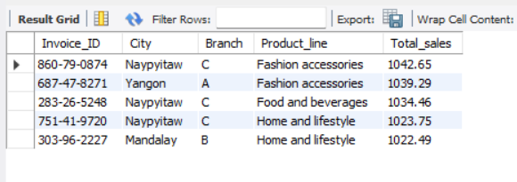
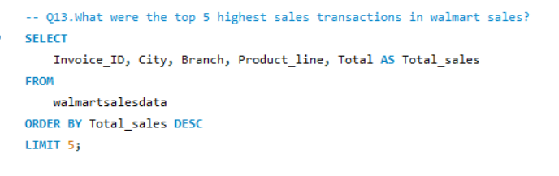
ANALYSIS:
Q13. What were the top 5 highest sales transactions in Walmart sales?
Answer:

Slide 18
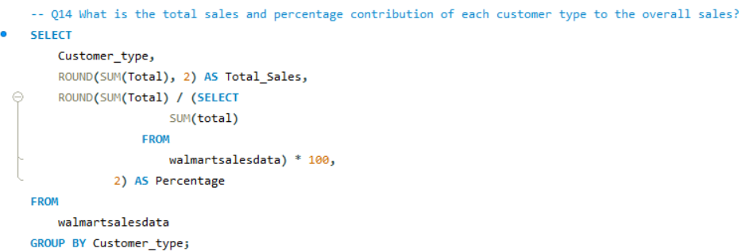
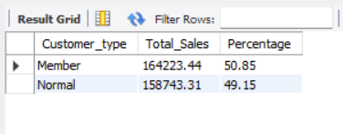
ANALYSIS:
Q14. What is the total sales and percentage contribution of each customer type to the overall sales?
Answer:

Slide 19
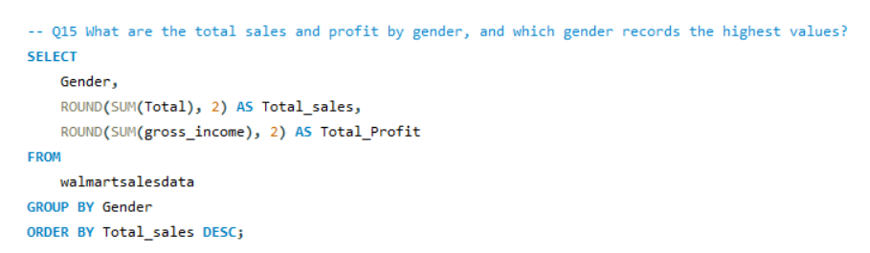
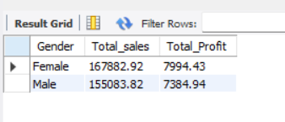
ANALYSIS:
Q15.What are the total sales and profit by gender, and which gender records the highest values?
Answer:

Slide 20
KEY INSIGHTS:
1.Revenue & Transactions
Total Revenue Highest in Naypyitaw city, followed by Yangon, then Mandalay
Average revenue per transaction is around USD 322.97
Females' contribution are higher than male in sales & Profit
2.Branch Performance
Branch C generates the highest sales, while Branch B has the lowest.
3. Product Lines
Food & beverages and Sports &Travel leads in total sales and high average Ratings
4. Customer Types
Members spend slightly more per transaction than Normal customers.
Members also give higher ratings on average.
5. Payment Methods
Cash is the most popular, followed by E-wallet and Credit Card.
Till time Cash Payment are dominant
6. Time-based Trends
Peak sales hours are between 13:00 and 19:00.
Weekdays generate higher total sales compared to Weekends
7. Customer Satisfaction
Average customer rating across all branches is around 6.9-7.5,
with Mandalay having slightly lower ratings

Slide 21
Recommendations:
1.Boost Sales in Lower-Performing Branches
Increase marketing efforts and promotional campaigns in Branch C (Naypyitaw).
2. Expand Popular Product Lines
Increase stock and offer discounts on Electronic Accessories and Fashion Accessories.
3. Leverage Digital Payments
Promote e-wallet discounts to encourage more cashless transactions.
4. Customer Loyalty Programs
Strengthen membership programs since members spend more and give better ratings.
5. Optimize Store Hours
Allocate more staff during peak hours (1 PM – 3 PM) to improve service quality and increase sales.
6. Improve Customer Experience
Focus on training staff in Mandalay to improve service quality and ratings

Slide 22
CONCLUSION:
The Walmart sales data reveals that Naypyitaw and Branch C are top revenue contributor, while specific product lines generate most revenue and other have needs for improvements.
Cash payment are slightly dominant followed by E-wallet and credit card; digital payment will improve by promoting cashless transactions.
Walmart can boosted low performing branches and product lines through target marketing, giving offer/discounts ,focus on customer demanding products etc.
Highest Sales of the month is January following March and February, suggesting customer purchase patterns that can be targeted with promotions.
By applying this plan of actions, Walmart has potential to improve market share, improve profitability and meets customer needs.

Slide 23
! THANK YOU !

